Slide 1

Digital Image Processing
19-Discuss the difference between global and local histogram equalization.
Global histogram equalization:
is applied to the entire image باكملها ( the image is treated as one )
Local histogram equalization:
is applied on a defined neighborhood around the pixel moving its center from pixel to pixel.

Slide 2
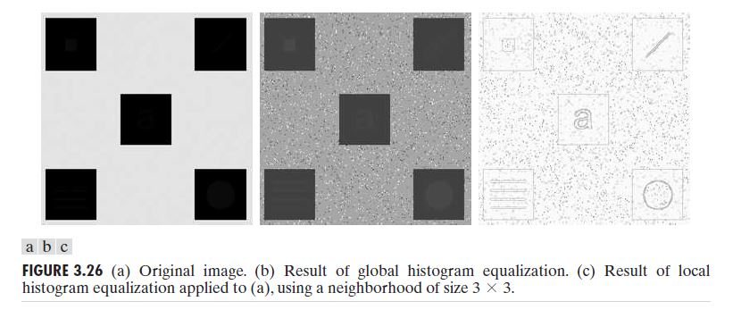
Digital Image Processing
19-Discuss the difference between global and local histogram equalization.

